Slide 1
CPSC331 - Spring 2019 Tutorial 20
Khobaib Zaamout

Slide 2
Q1: Depth first search
Q1: Recall that the breadth first search algorithm uses a queue to store vertices that are currently coloured grey. Most of the work of the algorithm is performed through the execution of a while loop that ends when the queue is empty.
Describe how depth first search can be implemented in much the same way — except that a stack is used to store grey vertices instead of a queue.
Hint: It helps to review the information in the lecture on stacks, notably including the use of call stacks to execute recursive algorithms.

Slide 3
Q1: Depth first search
Answer:
A consideration of the breadth-first search algorithm should confirm that all you need to do is push a node onto the stack when its colour is changed from white to grey.
When this node is seen again, at the top of the stack, it should be checked whether this node still has any white neighbours.
If a white neighbour is seen then this should be re-coloured as grey and pushed onto the stack — with processing continuing with this neighbour.
If it no longer has any white neighbour then its colour should be changed to black as it is popped off the stack.
Assuming that neighbours of each node are listed in a consistent way, it can be proved by induction on the number of calls to the dfs-visit algorithm, in the notes for Lecture #21, that an algorithm with a while loop that uses a stack to manage the grey nodes would process and colour nodes in the same order, eventually returning the same output as the recursive algorithm described during the lecture — so that it would also correctly solve the computational problem being considered.

Slide 4
Q2: Breadth first search
Q2: Now consider the breadth first search algorithm. Explain why each of the following claims is true at the beginning and end of every execution of the outer while loop as well as the beginning and end of every execution of the inner for loop in this algorithm. Then say how you could prove this more formally.

Slide 5
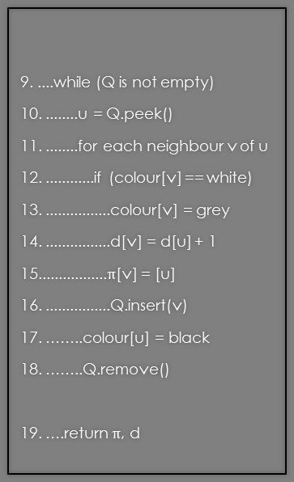
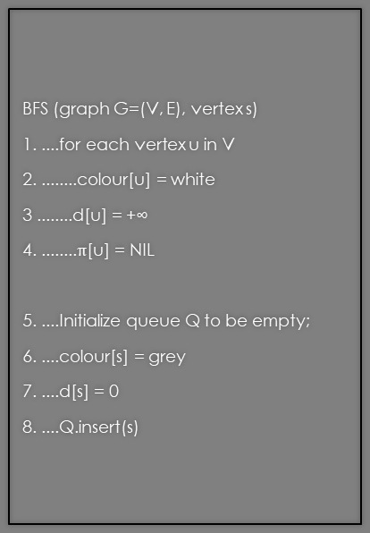
Q2: Breadth first search
(a) Every vertex that was stored on the queue before this, but that is not stored on it now, is black. Every vertex that is currently stored on the queue is grey. Every vertex that is not on the queue and that has never been stored on it before this is white.
BFS (graph G=(V, E), vertex s)
1. ....for each vertex u in V
2. ........colour[u] = white
3 ........d[u] = +∞
4. ........$π$[u] = NIL
5. ....Initialize queue Q to be empty;
6. ....colour[s] = grey
7. ....d[s] = 0
8. ....Q.insert(s)
9. ....while (Q is not empty)
10. ........u = Q.peek()
11. ........for each neighbour v of u
12. ............if (colour[v] == white)
13. ................colour[v] = grey
14. ................d[v] = d[u] + 1
15.................$π$[v] = [u]
16. ................Q.insert(v)
17. ……..colour[u] = black
18. ……..Q.remove()
19. ….return $π$, d

Slide 6
Q2: Breadth first search
This can be seen by inspection of the code in the BFS algorithm included in Lecture #21:
The colour of every vertex is initialized to be white using the for loop at lines 1–4, and the queue Q is initialized to be empty at line 5.
The only vertex to inserted onto the queue before the while loop is reached vertex s, at line 8 — and its colour has been changed to grey at line 6, before that. No vertices have been removed from the queue or coloured black yet, at all — so these claims are all satisfied when the while loop is first reached.
…

Slide 7
Q2: Breadth first search
Now consider an execution of the body of the while loop that begins with these claims being satisfied. Since the loop was checked and passed, there is some vertex u at the top of the queue, and it follows by these properties that it is currently grey.
The only vertices inserted into the queue are the white neighbours of u, using the step at line 16 — and the colour of each has been changed to grey before that, at line 13.
None of the grey or black neighbours have their colours changed, and none are inserted onto or removed from the queue. None of the nodes different from u, that are not neighbours of u, are accessed are modified at all.
The only vertex that is removed from the queue is the vertex u, at line 18, and its colour has been changed to black, at line 17, just before that.
…

Slide 8
Q2: Breadth first search
All of this can be used to establish the claims hold when the bottom of the body of the while loop is reached as well.
Since the loop test has no side-effects, Loop Theorem #1 can be applied to establish that these claims are all part of a correct loop invariant for the while loop in this algorithm.
Similarly (since the inner for loop’s test has no side-effects) it can be shown that this properly holds whenever the for loop is reached, at the beginning and end of every execution of the inner loop body, and when execution of this inner loop ends.
Thus (even though this never got defined) this would be part of a valid “loop invariant” for the inner for loop too.

Slide 9
Q2: Breadth first search
(b) The neighbours of any black vertex are either black or grey — and the neighbours of any white vertex are either grey or white.
BFS (graph G=(V, E), vertex s)
1. ....for each vertex u in V
2. ........colour[u] = white
3 ........d[u] = +∞
4. ........$π$[u] = NIL
5. ....Initialize queue Q to be empty;
6. ....colour[s] = grey
7. ....d[s] = 0
8. ....Q.insert(s)
9. ....while (Q is not empty)
10. ........u = Q.peek()
11. ........for each neighbour v of u
12. ............if (colour[v] == white)
13. ................colour[v] = grey
14. ................d[v] = d[u] + 1
15.................$π$[v] = [u]
16. ................Q.insert(v)
17. ……..colour[u] = black
18. ……..Q.remove()
19. ….return $π$, d

Slide 10
Q2: Breadth first search
This is reasonably easily established by inspection of the code
The colour of a vertex is only changed to black during the execution of the step at line 17, and all neighbours of this node whose colours where white before this were recoloured grey during the execution of the for loop immediately before this.
Once again, Loop Theorem #1 can be applied to establish that this claim is part of a loop invariant for the while loop in this algorithm.
Virtually the same argument establishes that this is a valid loop invariant for the inner loop too.

Slide 11
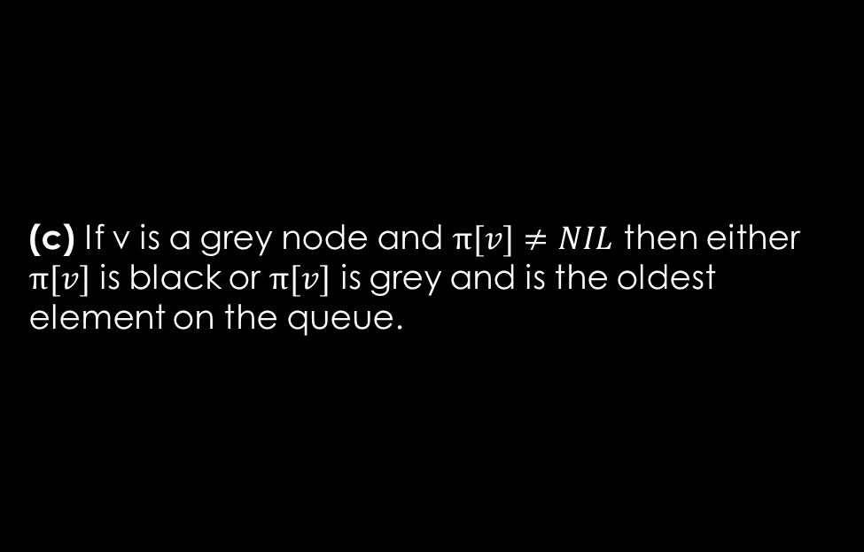
Q2: Breadth first search
(c) If v is a grey node and $π[v]≠NIL$ then either $π[v]$ is black or $π[v]$ is grey and is the oldest element on the queue.
BFS (graph G=(V, E), vertex s)
1. ....for each vertex u in V
2. ........colour[u] = white
3 ........d[u] = +∞
4. ........$π$[u] = NIL
5. ....Initialize queue Q to be empty;
6. ....colour[s] = grey
7. ....d[s] = 0
8. ....Q.insert(s)
9. ....while (Q is not empty)
10. ........u = Q.peek()
11. ........for each neighbour v of u
12. ............if (colour[v] == white)
13. ................colour[v] = grey
14. ................d[v] = d[u] + 1
15.................$π$[v] = [u]
16. ................Q.insert(v)
17. ……..colour[u] = black
18. ……..Q.remove()
19. ….return $π$, d

Slide 12
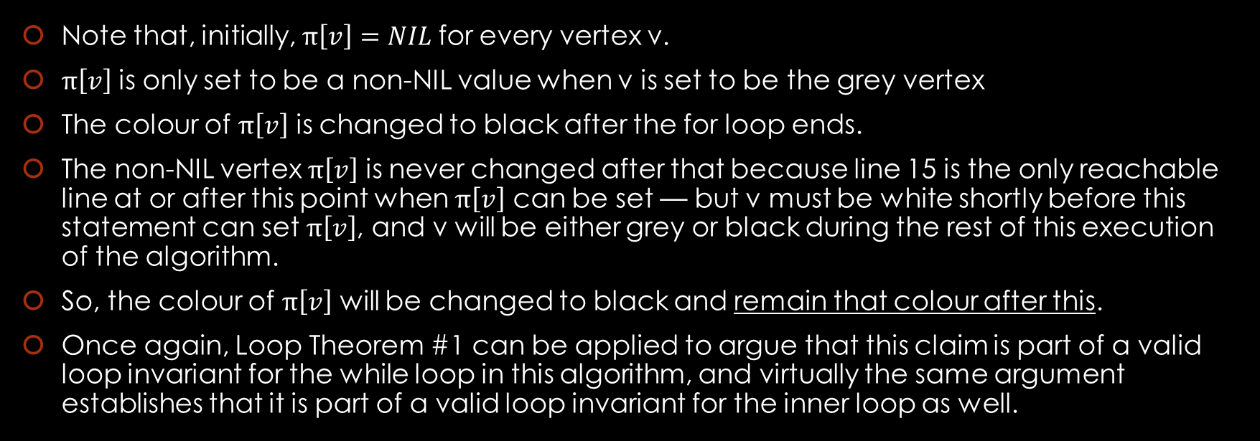
Q2: Breadth first search
Note that, initially, $π\left[v\right]=NIL$for every vertex v.
$π\left[v\right]$ is only set to be a non-NIL value when v is set to be the grey vertex
The colour of $π\left[v\right]$ is changed to black after the for loop ends.
The non-NIL vertex $π\left[v\right]$ is never changed after that because line 15 is the only reachable line at or after this point when $π\left[v\right]$ can be set — but v must be white shortly before this statement can set $π\left[v\right]$, and v will be either grey or black during the rest of this execution of the algorithm.
So, the colour of $π\left[v\right]$ will be changed to black and remain that colour after this.
Once again, Loop Theorem #1 can be applied to argue that this claim is part of a valid loop invariant for the while loop in this algorithm, and virtually the same argument establishes that it is part of a valid loop invariant for the inner loop as well.

Slide 13
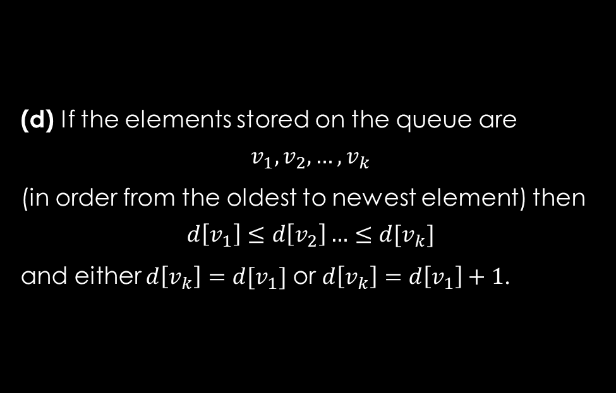
Q2: Breadth first search
(d) If the elements stored on the queue are
$$v_{1},v_{2},…,v_{k}$$
(in order from the oldest to newest element) then
$$d\left[v_{1}\right]≤d\left[v_{2}\right]…≤d[v_{k}]$$
and either $d\left[v_{k}\right]=d[v_{1}]$ or $d\left[v_{k}\right]=d\left[v_{1}\right]+1$.
BFS (graph G=(V, E), vertex s)
1. ....for each vertex u in V
2. ........colour[u] = white
3 ........d[u] = +∞
4. ........$π$[u] = NIL
5. ....Initialize queue Q to be empty;
6. ....colour[s] = grey
7. ....d[s] = 0
8. ....Q.insert(s)
9. ....while (Q is not empty)
10. ........u = Q.peek()
11. ........for each neighbour v of u
12. ............if (colour[v] == white)
13. ................colour[v] = grey
14. ................d[v] = d[u] + 1
15.................$π$[v] = [u]
16. ................Q.insert(v)
17. ……..colour[u] = black
18. ……..Q.remove()
19. ….return $π$, d

Slide 14
Q2: Breadth first search
The claim is trivially true before the while loop is reached.
If it is satisfied at the beginning of an execution of a loop body then it is true when the bottom of the body of the loop reached — for if a vertex u is being removed from the queue then the only values inserted onto the queue are formerly white neighbours v —and d[v] will be set to be d[u] + 1 for each of these vertices.
Once again, Loop Theorem #1 to be applied to establish that this is part of a valid loop invariant for the while loop. Again, a similar argument can be applied to establish this for the inner loop.

Slide 15
Q2: Breadth first search
(e) If u and v are vertices such that u is black and v is grey then neither d[u] nor d[v] is equal to +∞, and d[u] ≤ d[v]. On the other hand, if w is a white vertex then d[w] = +∞.
BFS (graph G=(V, E), vertex s)
1. ....for each vertex u in V
2. ........colour[u] = white
3 ........d[u] = +∞
4. ........$π$[u] = NIL
5. ....Initialize queue Q to be empty;
6. ....colour[s] = grey
7. ....d[s] = 0
8. ....Q.insert(s)
9. ....while (Q is not empty)
10. ........u = Q.peek()
11. ........for each neighbour v of u
12. ............if (colour[v] == white)
13. ................colour[v] = grey
14. ................d[v] = d[u] + 1
15.................$π$[v] = [u]
16. ................Q.insert(v)
17. ……..colour[u] = black
18. ……..Q.remove()
19. ….return $π$, d

Slide 16
Q2: Breadth first search
This is true when the while loop reached because v is white and d[v] = +∞ for every vertex v except for s. On the other hand, s is grey and d[s] = 0.
Since there are no black vertices at this point, all the claim is satisfied when the while loop is first reached.
Suppose the claim holds when at the beginning of an execution of the loop body.
Since the loop test was checked and passed the queue was not empty, and a vertex u will be removed from the queue and coloured black.
Since this is at the front of the queue it follows by the result of part (d) that d[u] ≤ d[v] for every other grey vertex that is currently on the queue.
Every vertex w that is inserted onto the queue will initially be a white neighbour of u; the colour of w will be changed to grey and d[w] will be set to be d[u] +1.
…

Slide 17
Q2: Breadth first search
Thus it will still be true if v is a black node and w is a grey node then d[v] ≤ d[w] when the above vertex u is coloured black and the bottom of the body of the loop is reached.
It will also be true, when the bottom of the loop body is reached, that d[v] = +∞ if and only if v is white, for every vertex v ∈ V: The only vertices whose colours change are formerly white neighbours of u, and their “distance” is changed to d[u] + 1 immediately afterwards.
Thus the claim holds when the bottom of the loop body is reached.
Once again, Loop Theorem #1 can be used to show that this is part of a valid loop invariant for the while loop in this algorithm. Again, a similar argument can be applied to establish this for the inner loop.

Slide 18
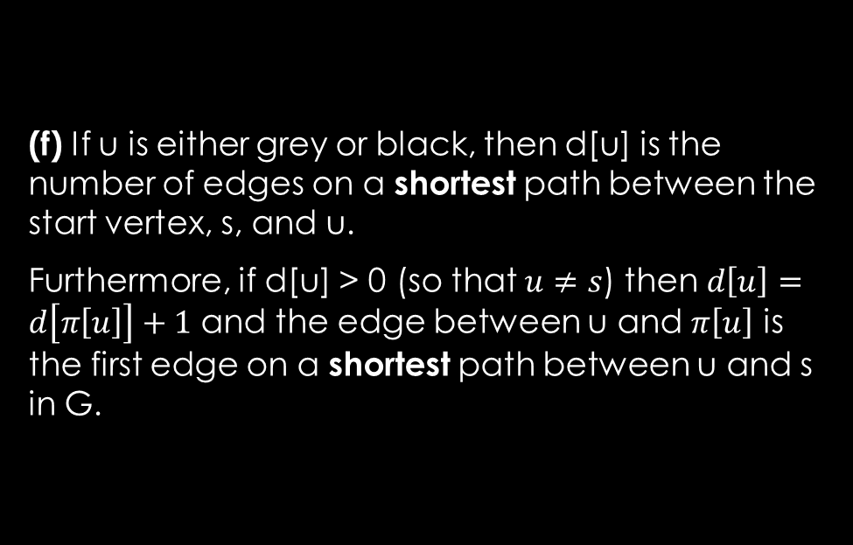
Q2: Breadth first search
(f) If u is either grey or black, then d[u] is the number of edges on a shortest path between the start vertex, s, and u.
Furthermore, if d[u] > 0 (so that $u≠s$) then $d\left[u\right]=d\left[π\left[u\right]\right]+1$ and the edge between u and $π\left[u\right]$ is the first edge on a shortest path between u and s in G.
BFS (graph G=(V, E), vertex s)
1. ....for each vertex u in V
2. ........colour[u] = white
3 ........d[u] = +∞
4. ........$π$[u] = NIL
5. ....Initialize queue Q to be empty;
6. ....colour[s] = grey
7. ....d[s] = 0
8. ....Q.insert(s)
9. ....while (Q is not empty)
10. ........u = Q.peek()
11. ........for each neighbour v of u
12. ............if (colour[v] == white)
13. ................colour[v] = grey
14. ................d[v] = d[u] + 1
15.................$π$[v] = [u]
16. ................Q.insert(v)
17. ……..colour[u] = black
18. ……..Q.remove()
19. ….return $π$, d

Slide 19
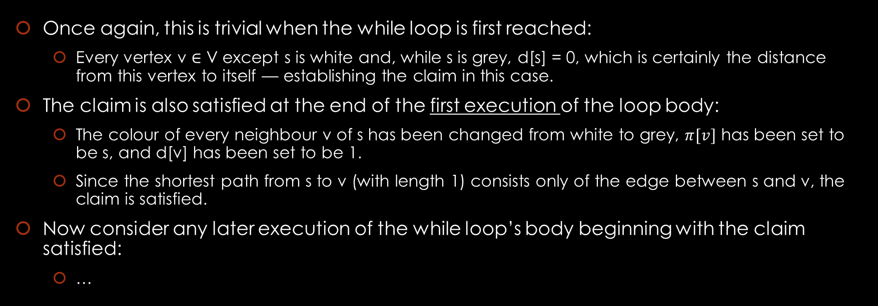
Q2: Breadth first search
Once again, this is trivial when the while loop is first reached:
Every vertex v ∈ V except s is white and, while s is grey, d[s] = 0, which is certainly the distance from this vertex to itself — establishing the claim in this case.
The claim is also satisfied at the end of the first execution of the loop body:
The colour of every neighbour v of s has been changed from white to grey, $π[v]$ has been set to be s, and d[v] has been set to be 1.
Since the shortest path from s to v (with length 1) consists only of the edge between s and v, the claim is satisfied.
Now consider any later execution of the while loop’s body beginning with the claim satisfied:
…

Slide 20
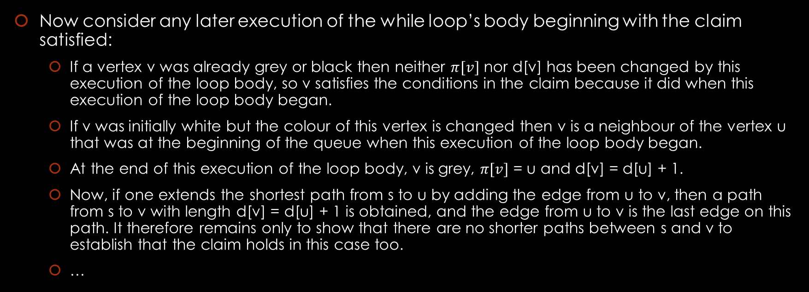
Q2: Breadth first search
Now consider any later execution of the while loop’s body beginning with the claim satisfied:
If a vertex v was already grey or black then neither $π[v]$ nor d[v] has been changed by this execution of the loop body, so v satisfies the conditions in the claim because it did when this execution of the loop body began.
If v was initially white but the colour of this vertex is changed then v is a neighbour of the vertex u that was at the beginning of the queue when this execution of the loop body began.
At the end of this execution of the loop body, v is grey, $π[v]$ = u and d[v] = d[u] + 1.
Now, if one extends the shortest path from s to u by adding the edge from u to v, then a path from s to v with length d[v] = d[u] + 1 is obtained, and the edge from u to v is the last edge on this path. It therefore remains only to show that there are no shorter paths between s and v to establish that the claim holds in this case too.
…

Slide 21
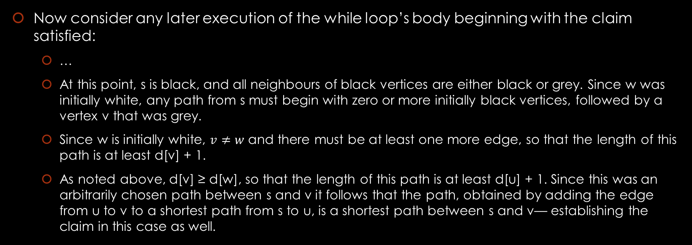
Q2: Breadth first search
Now consider any later execution of the while loop’s body beginning with the claim satisfied:
…
At this point, s is black, and all neighbours of black vertices are either black or grey. Since w was initially white, any path from s must begin with zero or more initially black vertices, followed by a vertex v that was grey.
Since w is initially white, $v≠w$ and there must be at least one more edge, so that the length of this path is at least d[v] + 1.
As noted above, d[v] ≥ d[w], so that the length of this path is at least d[u] + 1. Since this was an arbitrarily chosen path between s and v it follows that the path, obtained by adding the edge from u to v to a shortest path from s to u, is a shortest path between s and v— establishing the claim in this case as well.

Slide 22
Q2: Breadth first search
Now consider any later execution of the while loop’s body beginning with the claim satisfied:
…
Finally, if v was initially white and is still white when the bottom of the loop body is reached, then there is nothing that must be proved about v.
It follows that the claim is satisfied, once again, when the bottom of the loop body is reached.
Loop Theorem #1 can be applied, using the above observations, that this claim is part of a valid loop invariant for the while loop in this algorithm as well.
Once again, essentially the same argument can be applied when considering the inner loop.

Slide 23
Q3: Breadth first search
Q3: Use the above to argue that if the breadth first search algorithm is executed with a graph G and vertex s as input then:
on termination of this execution, every vertex v is reachable from the start vertex s if and only if its colour is black at the end of the execution of the algorithm
and that d[v] is the number of edges on a shortest path between s and v if v is black

Slide 24
Q3: Breadth first search
Suppose that this algorithm is executed and the execution of the algorithm terminates — so that the while loop is reached and executed and the execution of the loop eventually ends.
At this point, since the loop test at line 9 has been checked the queue is empty — so there are no grey vertices.
It follows by Q2a, b, and c that every neighbour of a black vertex is black, and that every neighbour of a white vertex is white.
Since every black vertex v has been included in the predecessor subgraph, each is reachable from s, and it follows by the claims in the loop invariant, given above, that d[v] is the distance from s to v.
It can also be proved — by induction on the length of a path from s to any other vertex v — that every vertex that is reachable from s is black, as required to establish the claim.

